Slide 1
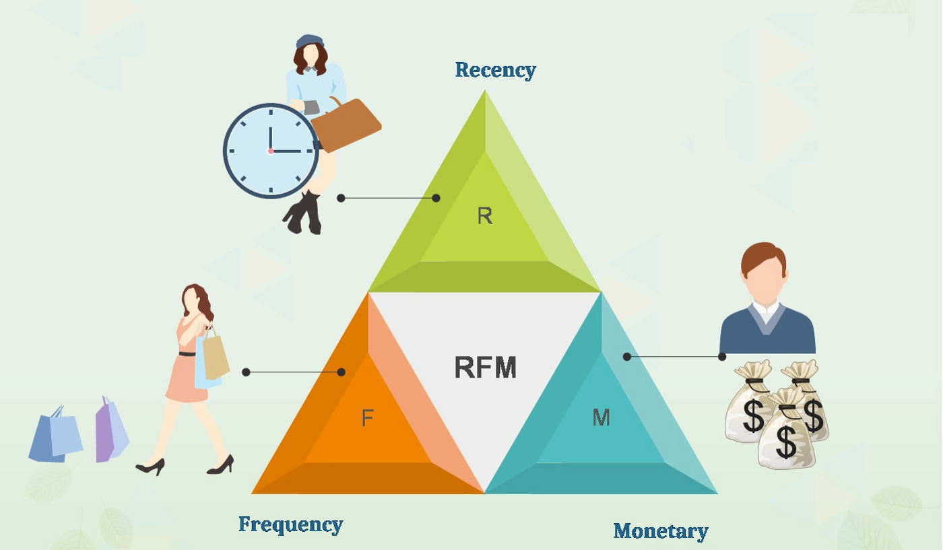
RFM Analysis

Slide 2
What is RFM?
Recency (R) as days since last purchase: How many days ago was their last purchase? Deduct most recent purchase date from today to calculate the recency value. 1 day ago? 14 days ago? 500 days ago?
Frequency (F) as the total number of transactions: How many times has the customer purchased from our store? For example, if someone placed 10 orders over a period of time, their frequency is 10.
Monetary (M) as total money spent: How many $$ (or whatever is your currency of calculation) has this customer spent? Simply total up the money from all transactions to get the M value.

Slide 3
RFM segmentation readily answers these questions for your business…
Who are my best customers?
Which customers are at the verge of churning?
Who are lost customers that you don’t need to pay much attention to?
Who are your loyal customers?
Which customers you must retain?
Who has the potential to be converted into more profitable customers?
Which group of customers is most likely to respond to your current campaign?

Slide 4
1. Core - Your Best Customers
RFM Score: 444
Who They Are: Highly engaged customers who have bought the most recent, the most often, and generated the most revenue.
Marketing Strategies: Focus on loyalty programs and new product introductions. These customers have proven to have a higher willingness to pay, so don't use discount pricing to generate incremental sales. Instead, focus on value added offers through product recommendations based on previous purchases.

Slide 5
2. Loyal - Your Most Loyal Customers
RFM Score: X4X
Who They Are: Customers who buy the most often from your store.
Marketing Strategies: Loyalty programs are effective for these repeated visitors. Advocacy programs and reviews are also common X4X strategies. Lastly, consider rewarding these customers with Free Shipping or other like benefits.

Slide 6
3. Whales - Your Highest Paying Customers
RFM Score: XX4
Who They Are: Customers who have generated the most revenue for your store.
Marketing Strategies: These customers have demonstrated a high willingness to pay. Consider premium offers, subscription tiers, luxury products, or value add cross/up-sells to increase AOV(Average Order Value). Don't waste margin on discounts.

Slide 7
4. Promising - Faithful customers
RFM Score: X41, X42
Who They Are: Customers who return often, but do not spend a lot.
Marketing Strategies: You've already succeeded in creating loyalty. Focus on increasing monetization through product recommendations based on past purchases and incentives tied to spending thresholds (pegged to your store AOV).

Slide 8
5. Rookies - Your Newest Customers
RFM Score: 41X
Who They Are: First time buyers on your site.
Marketing Strategies: Most customers never graduate to loyal. Having clear strategies in place for first time buyers such as triggered welcome emails will pay dividends.

Slide 9
6. Slipping - Once Loyal, Now Gone
RFM Score: 11X
Who They Are: Great past customers who haven't bought in awhile.
Marketing Strategies: Customers leave for a variety of reasons. Depending on your situation price deals, new product launches, or other retention strategies.

